Slide 1
Bullying Detection through Graph Machine Learning
Applying Neo4j’s Unsupervised Graph Learning Techniques to the Friends Dataset
Notes:
TA FRAM LASER POINTER
Ge snabb överblick över projektet.

Slide 2


Background
Notes:
Every day students are dealing with the impacts of bullying. This problem not only affects the well-being of students but also leaves long-lasting psychological issues.
Our goal is to understand bullying by using unsupervised Graph Machine Learning techniques in Neo4j .
Our project represents a union between behavioral science, Friends, and data science, Tietoevry using data that Friends have gathered through surveys. With this unique approach, we’ve tried to find new ways to fight bullying.
-------------------------------------
Varje dag hanterar elever konsekvenserna av mobbning. Detta problem påverkar inte bara elevernas vardag utan lämnar även långvariga psykologiska problem.
Vårt mål är att förstå mobbning genom att använda unsupervised Graph Machine Learning-tekniker i Neo4j.
Vårt projekt representerar ett samarbete mellan beteendevetenskap, Friends, och datavetenskap, Tietoevry, och använder data som Friends har samlat in genom svarsenkäter. Med denna unika metod har vi försökt hitta ett nytt sätt att bekämpa mobbning.

Slide 3
Research Questions
RQ1:
How can unsupervised GML techniques in Neo4j be applied to the Friends dataset to identify patterns or clusters that may indicate bullying behavior?
RQ2:
How can these patterns, combined with domain knowledge from behavior science, be used to reveal hidden relationships that can indicate a likelihood of bullying?
Notes:
RQ1: Doing
RQ2: Analyzing

Slide 4
Methodology
Notes:
How did we do?
Collaboration with domain experts
Data preprocessing
Prepare for GML
Machine learning
Result validation
Visualization

Slide 5

Methodology – Collaboration
Notes:
Associate professor in behavioral science Björn Johansson, Örebro University
Domain experts from Friends
Åsa Gustafsson, one of them
Docent i beteendevetenskap, Björn Johansson, Örebro Universitet
Experter från Friends
Åsa Gustafsson, en av dem

Slide 6
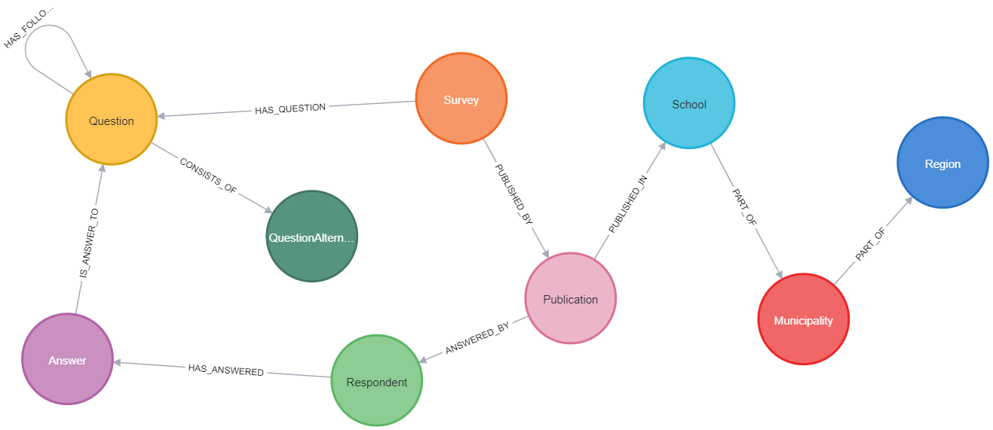
Methodology – Neo4j
Notes:
This is the database schema from Neo4j of the friends data
Neo4j
Graph-based DBMS
Visualization
Machine Learning / data science algorithms
Friends dataset
3000 students
50 questions / student

Slide 7
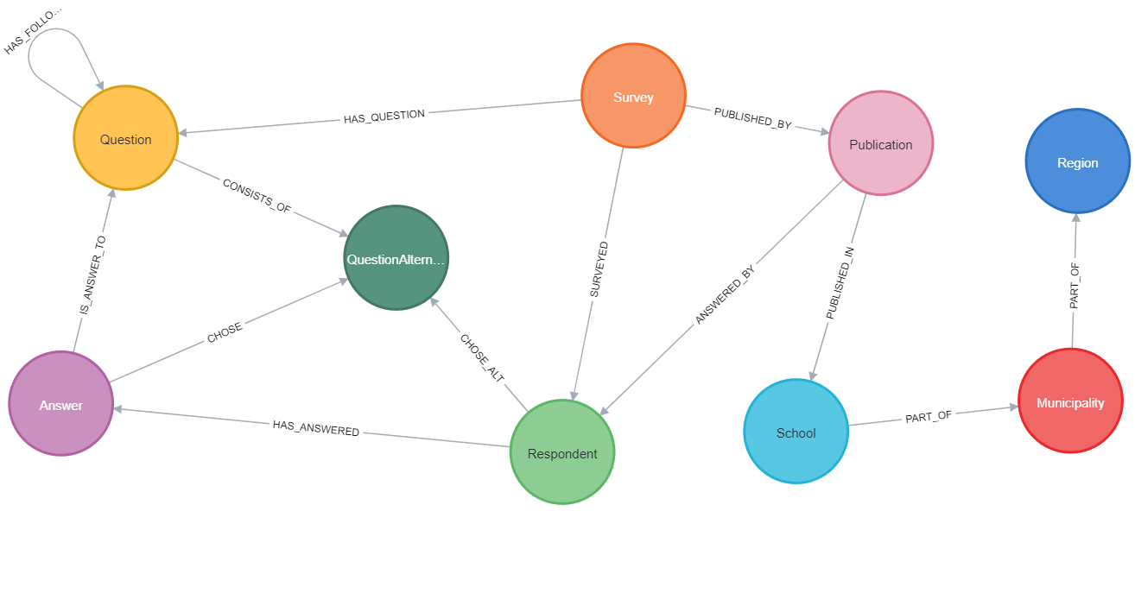
Methodology – Data Preprocessing
Notes:
Not optimized for GML
Answer connected to QuestionAlternative through id property, not optimal
☺
Added relationship between QuestionAlternative and Respondent
Other improvements were done but not as relevant.

Slide 8
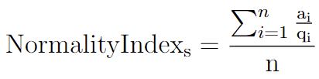
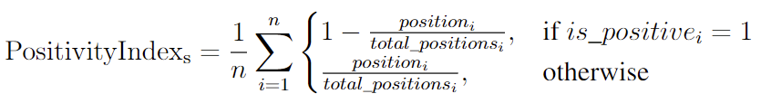
Methodology – Indices
Notes:
CHRISTOFFER!!!
Normality Index
Knew we needed a way of comparing the results. This is the index used for the axes in our graphs later seen.
Emerged from a discussion with Åsa Gustafsson, Friends.
Measures the student’s deviation from the norm. Closer to 1 is normal, and closer to 0 is deviant.
Student s.
ai is the number of responses given by students for option connected to question i
qi is the total number of responses given by students for question i
n represents the number of questions answered by the student
Positivity Index
Knew we needed a way of validating the results. This is the index used when validating the results received from the unsupervised gml.
Originates from a discussion with Dr. Johansson Örebro University.
Measures the positivity of a student’s answers to school climate and victimization questions
Positivity for a student s
n is the total number of questions answered by the student
position i is the position of the chosen answer for question i
total_positions i is the total number of answer positions for question i
is_positive i indicates whether the question i is positively framed

Slide 9
Implementation & Results
Notes:
Interesting / Successful experiments with results
Other experiments
Louvain
Node Similarity
Simulated Expert Predictions
Other experiments
LPA
WCC
kNN Similarity

Slide 10
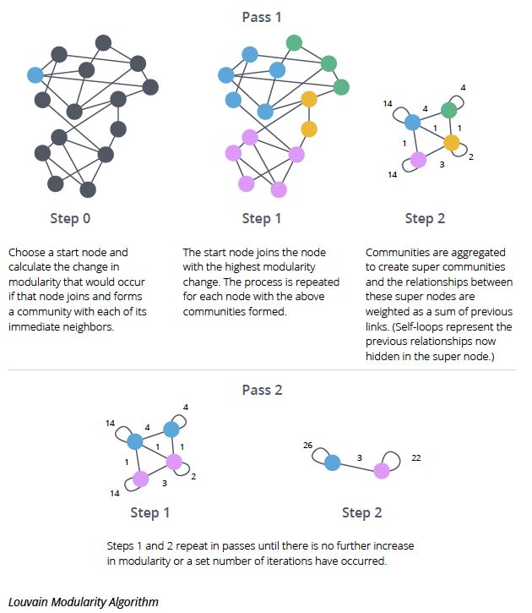
Implementation – Louvain
Source: Adapted from [3]
Notes:
Tried another algorithm
Community detection algorithm - Optimized modularity
Graphs with high modularity have dense connections between the nodes within modules but sparse connections between nodes in different modules.
Each node separate community, iteratively merges communities based on modularity

Slide 11
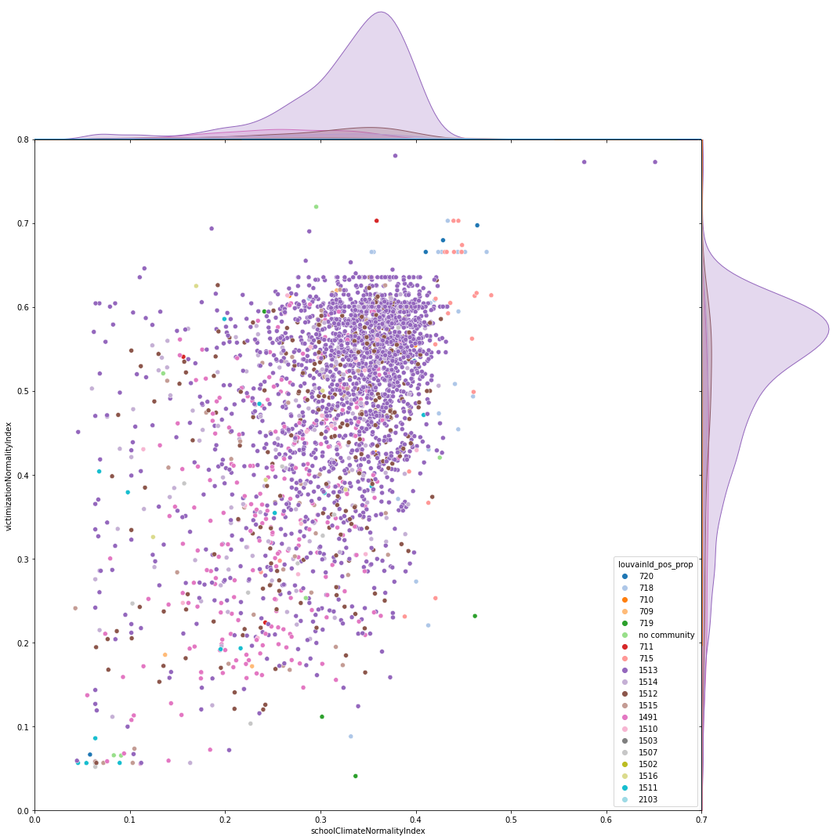
Results – Louvain
Notes:
X-axis = Normality index based only of questions on school climate
Y-axis = Normality index based only of questions on victimization
Top right = You answered according to the norm on both question categories
Bottom left = You answered deviating on both question categories
Want to find outlier clusters
These are not optimal results but to improve the results, we wanted relationships among students ☺

Slide 12

Implementation – Similarity
Notes:
…hence, the introduction of similarity relationship

Slide 13
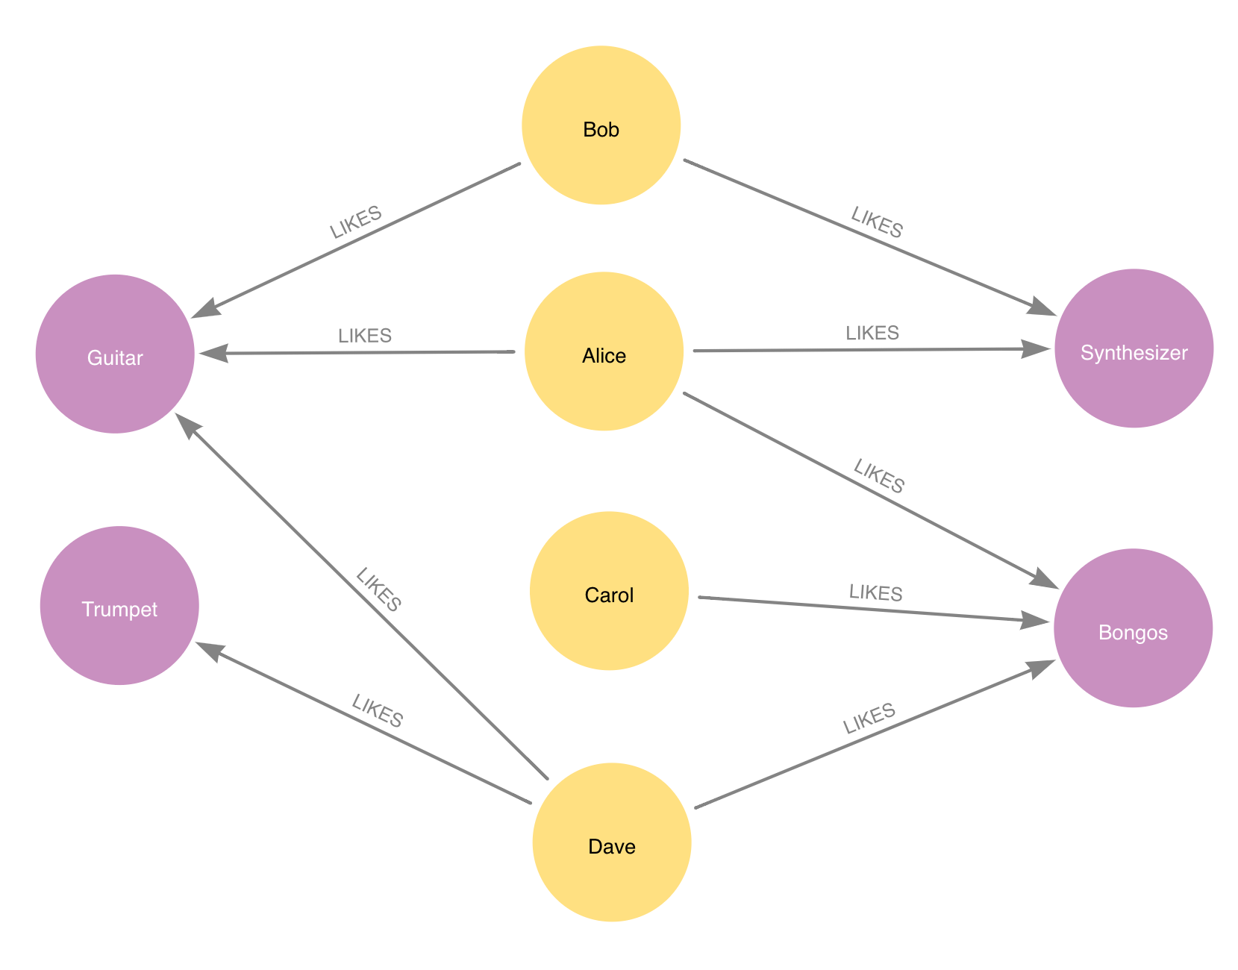
Implementation – Node Similarity
Source: Adapted from [1]
Notes:
Node Similarity, an algorithm to measure similarity
For example, Bob – Alice, 3 distinct neighbors, 2 shared = 2/3

Slide 14
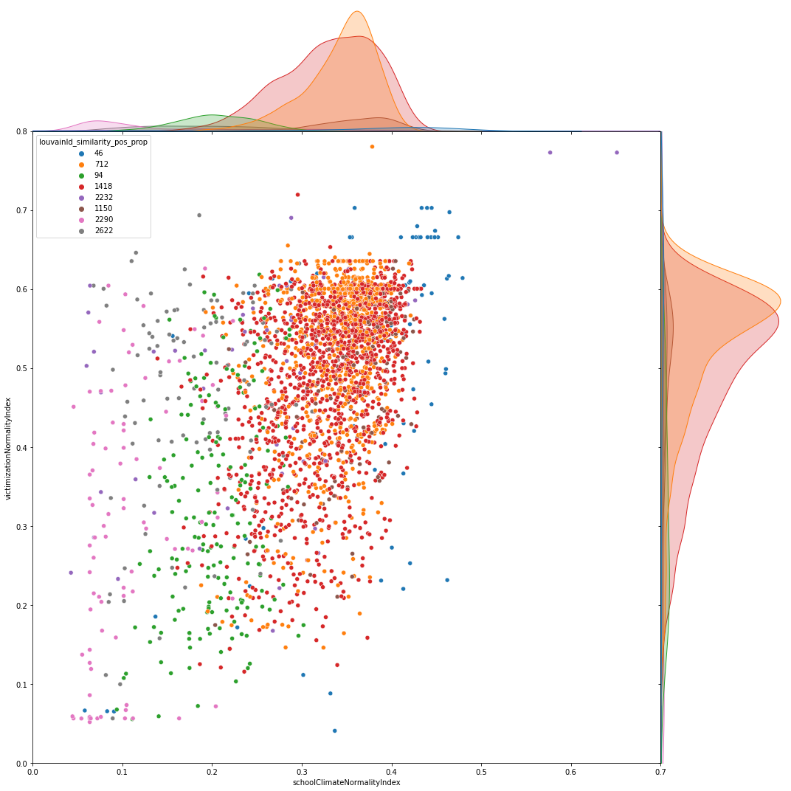
Results – Louvain
with Node Similarity
Notes:
Community 94 almost 7% of the population
Scores low on the normality index based on school climate
Size in accordance with the proportion of bullied students corresponding to the field of behavior science 6-9%.
The hypothesis that this is a bullied cluster is asserted when zooming in on victimization and school climate answers ☺

Slide 15
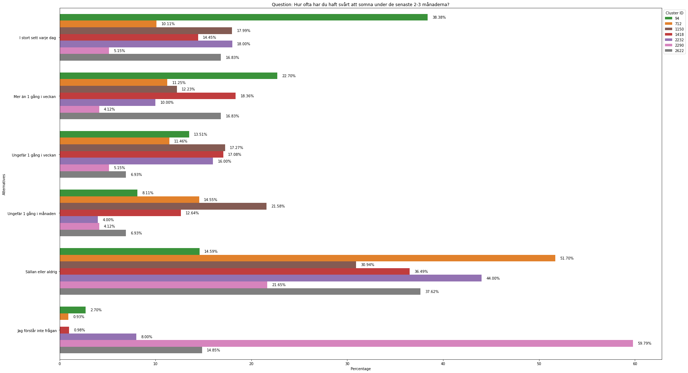
Results – Louvain – Victimization
Notes:
Explain question
Explain the axes

Slide 16
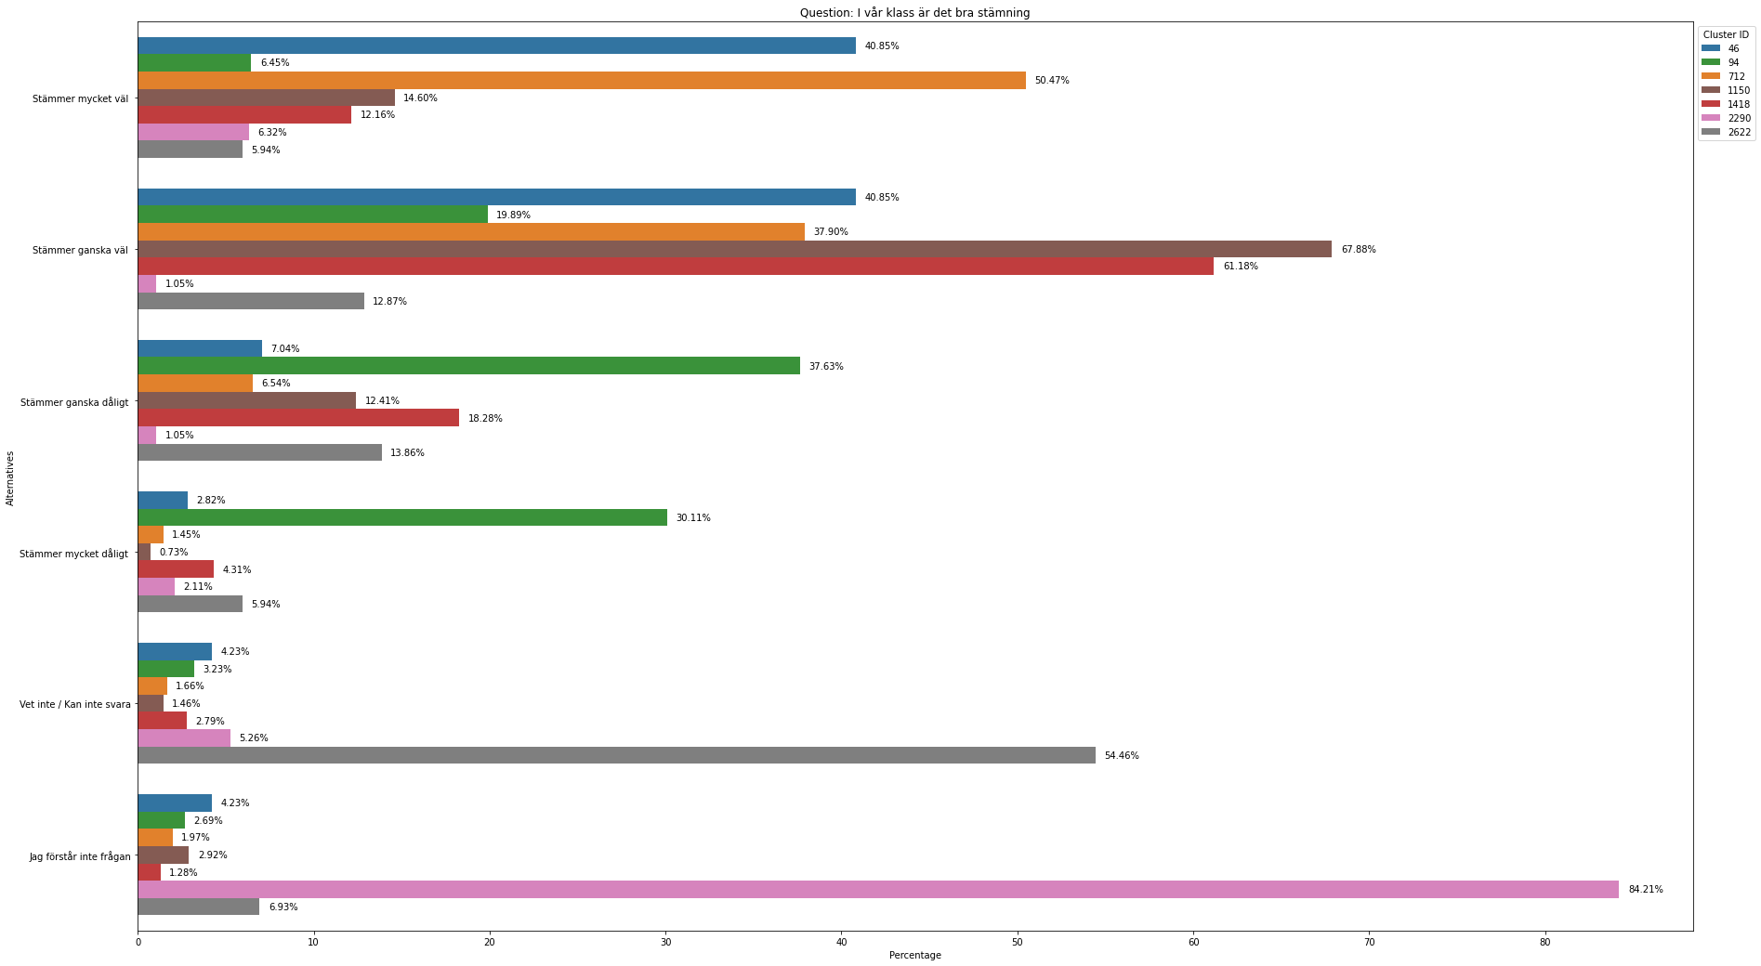
Results – Louvain – School Climate

Slide 17
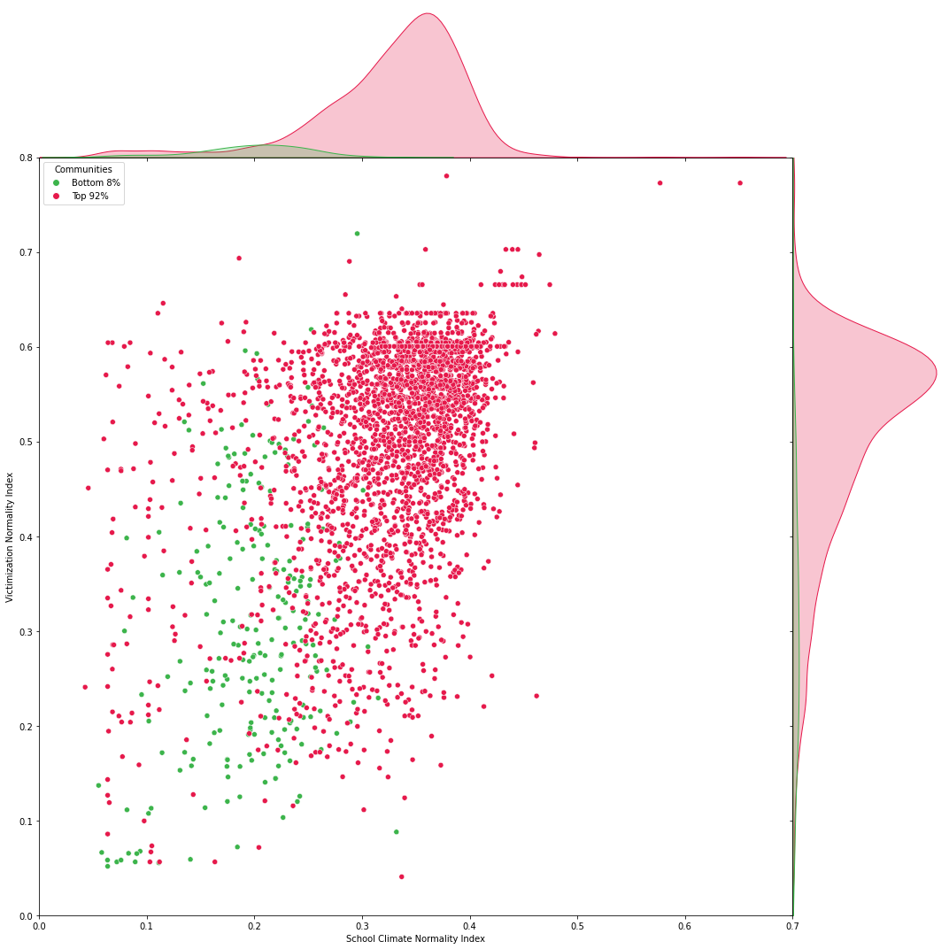
Results – Simulated Expert Predictions
Notes:
Dr. Johansson Associate Professor in behavioural science, Örebro University
Bottom 8% = Lowest scoring students on positivity index = Expert Simulated ”bullied” cluster
☺
78.3% of the expert predictions are in community 94.
This further support our hypothesis that louvain with sim. Community 94 is a bullied community.
Future work: Analyzing students that are in community 94 but not in expert simulated commuity.

Slide 18


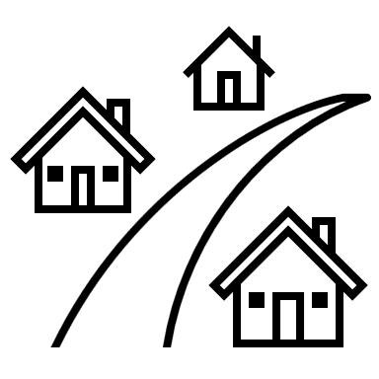

Future Work
Notes:
Use the entire dataset for ml
Expand the dataset with openly available data on schools
Convert old Friends data into neo4j
Use classification from domain expert as seed labels for LPA
Perform kNN algorithm without relation to QuestionAlternative
Compare Neo4j to other ML tools
Analyze and validate the normality/positivity index further
Visualize based on the positivity index
Analyze based on the normality indexAnalyze and validate data preprocessing
Expand the set of domain experts
Analyze results further

Slide 19
References
[1] | Neo4j, “Node Similarity” [Online]. Available: https://neo4j.com/docs/graph-data-science/current/algorithms/node-similarity/ [Accessed: 2023-05-22]
[2] | M. Needham and A. Hodler, “Graph Algorithms in Neo4j: Label Propagation” [Online]. Available: https://neo4j.com/blog/graph-algorithms-neo4j-label-propagation/ [Accessed: 2023-05-22]
[3] | M. Needham and A. Hodler, “Graph Algorithms in Neo4j: Louvain Modularity” [Online]. Available: https://neo4j.com/blog/graph-algorithms-neo4j-louvain-modularity/ [Accessed: 2023-05-22]
Notes:
https://neo4j.com/blog/graph-algorithms-neo4j-weakly-connected-components/

